Slide 1

DATA ANALYTICS
FOR BETTER BUSINESS DECISONS
Problem Statement:
Understanding Career Aspiration of Gen-Zs
Presented by Palak

Slide 2





Our Learning Roadmap Success
The Final Insight
Creating Focus area Dashboards.
Creating a comprehensive Dashboard.
Analysis of Business questions using SQL.
Collecting the data and cleaning It using SQL.
Approaching the problem statement and creating a Business Research Document.
Introduction to the problem statement and researching about it to get a better understanding.

Slide 3

Introduction to the problem statement and researching about it to get a better understanding.
For the problem statement, we will be going to discuss about Generation Z. The generation which was born between 1995 to 2012 in the era where technology was introduced, internet started penetrating, and there was social and economic change in the world. This generation is persistent, rebellious and ambitious towards future. These people want to make impact on this world more than any other generations.
Their characteristics include Digital natives, tech-savvy, diverse, socially conscious, short attention span, global perspective, independent thinkers, flexible and adaptable.
However, in the corporate world, Gen Z’ s are not understood by the Employers, as a result of which both faces problems at workplace. So, in this project we will understand the gap and help the recruiters get the right people at right place in the organizations.
Here are some articles for better research and understanding:
https://www.linkedin.com/pulse/gen-z-career-aspirations-future-work-eliane-miles/
https://medium.com/@em4kraist/career-aspiration-of-gen-zers-e93eec3ddf43

Slide 4
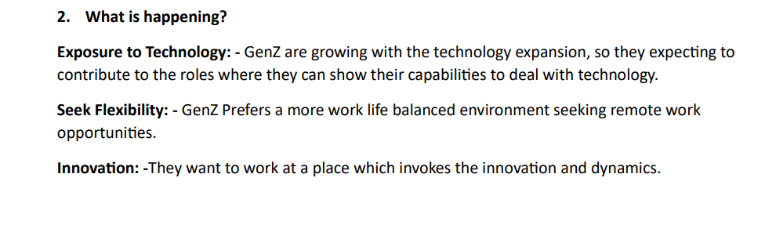
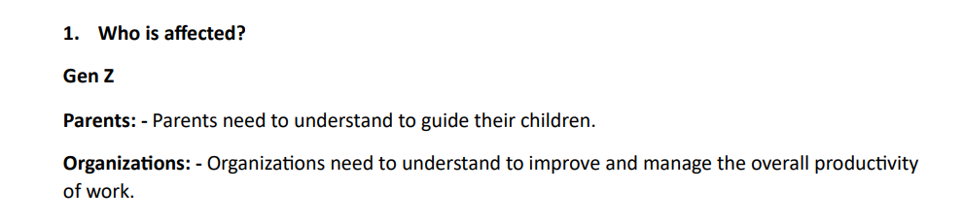
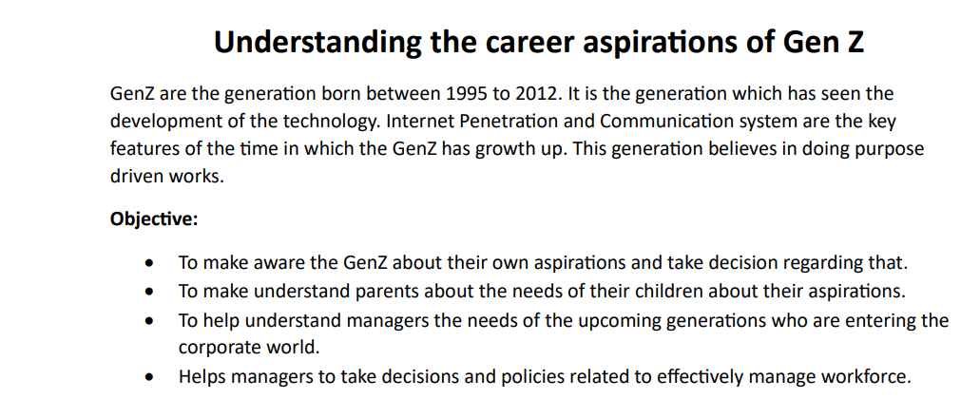
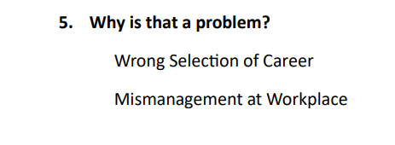
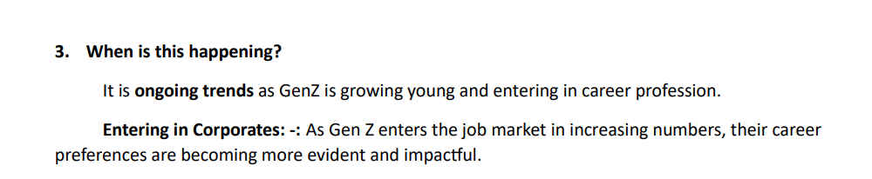
Approaching the problem statement and creating a Business Research Document

Slide 5
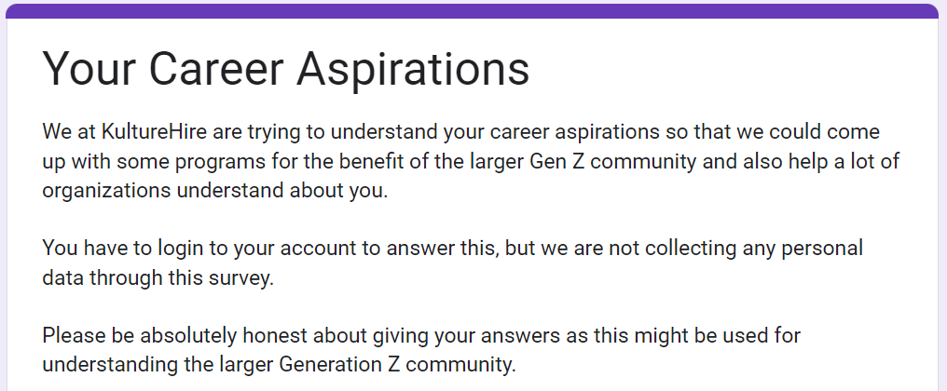
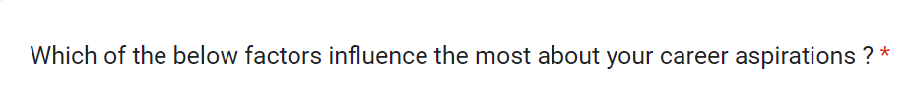
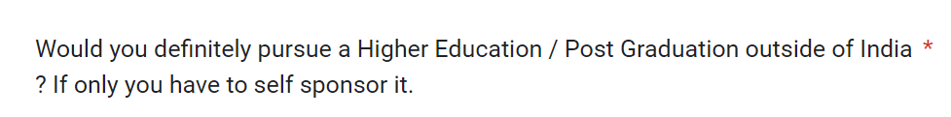
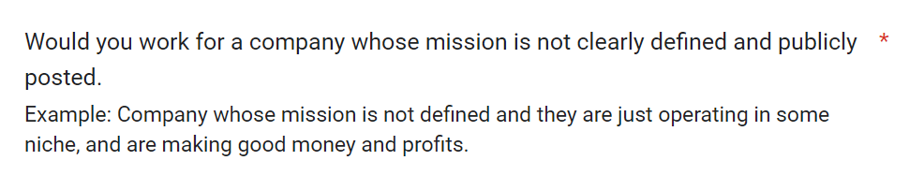
Data Collection
Data collection improves customer experience and drives better decision-making and overall growth for businesses across the board.
For our problem statement we gathered data from the Gen-Zs through platforms like LinkedIn, Instagram, etc.
We received around 3582 complete forms. The responses were roughly from 3457 different Postal codes across India.

Slide 6
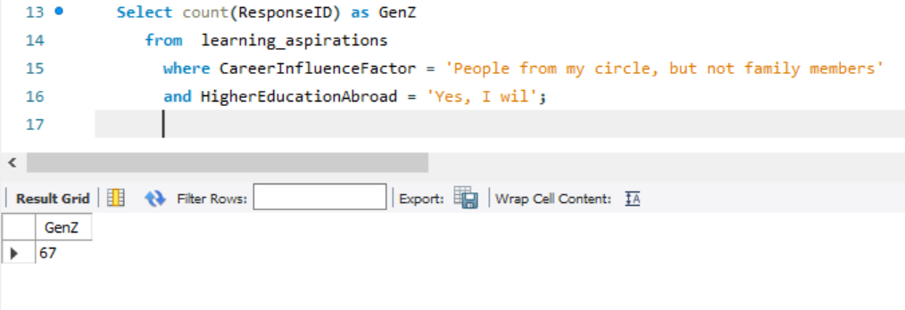
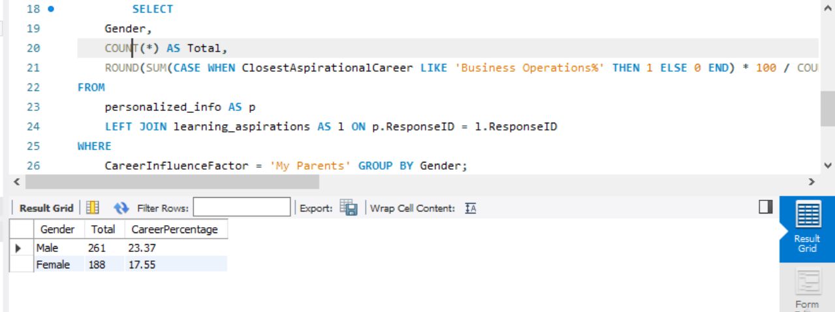
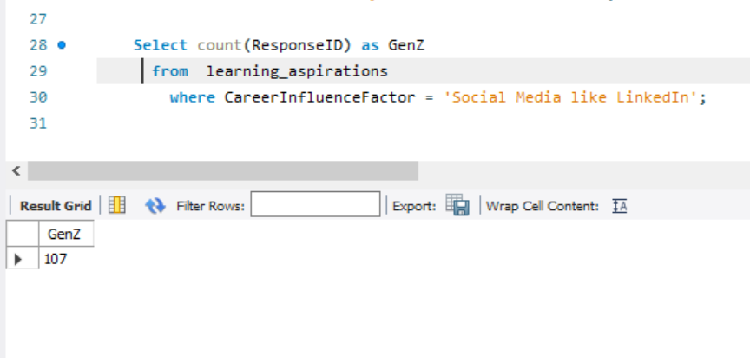
Cleaning the Data And Answering the Business Questions
We worked on MYSQL Server Workbench. Imported data from csv and xlsx files to the server, wrote codes to get the answers to the required for the Analysis of Business questions.
We solved 22 business questions and here we have some snippets of the codes along with the outputs:

Slide 7
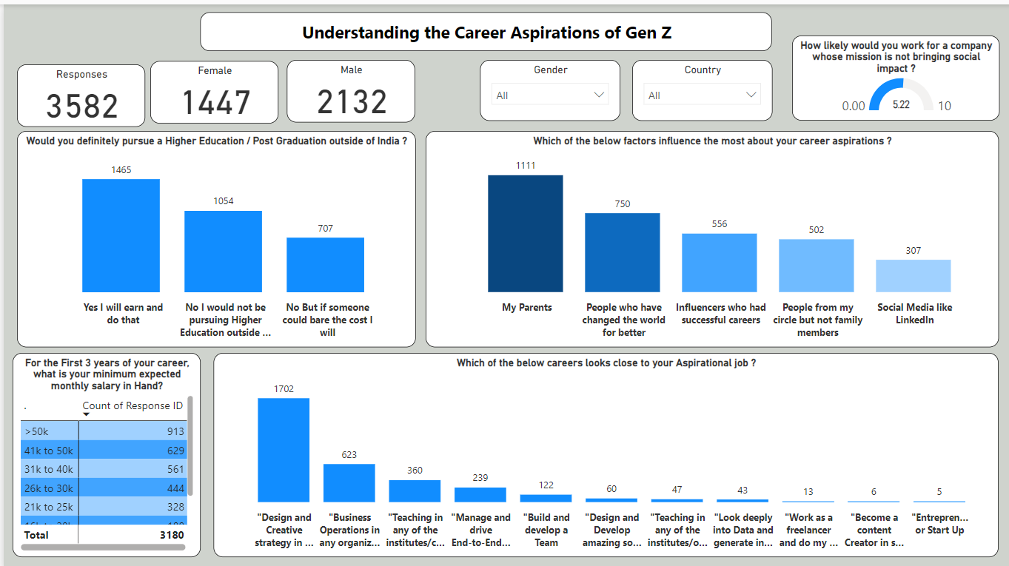
A Comprehensive Dashboard

Slide 8
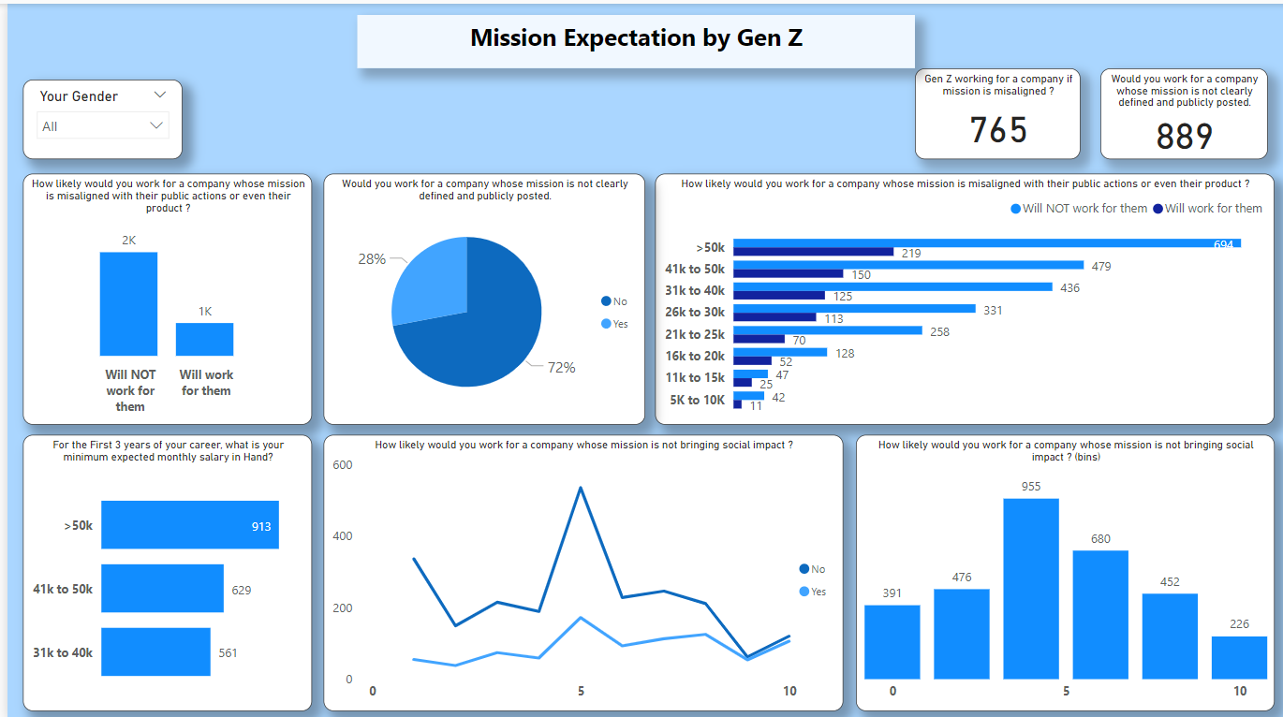
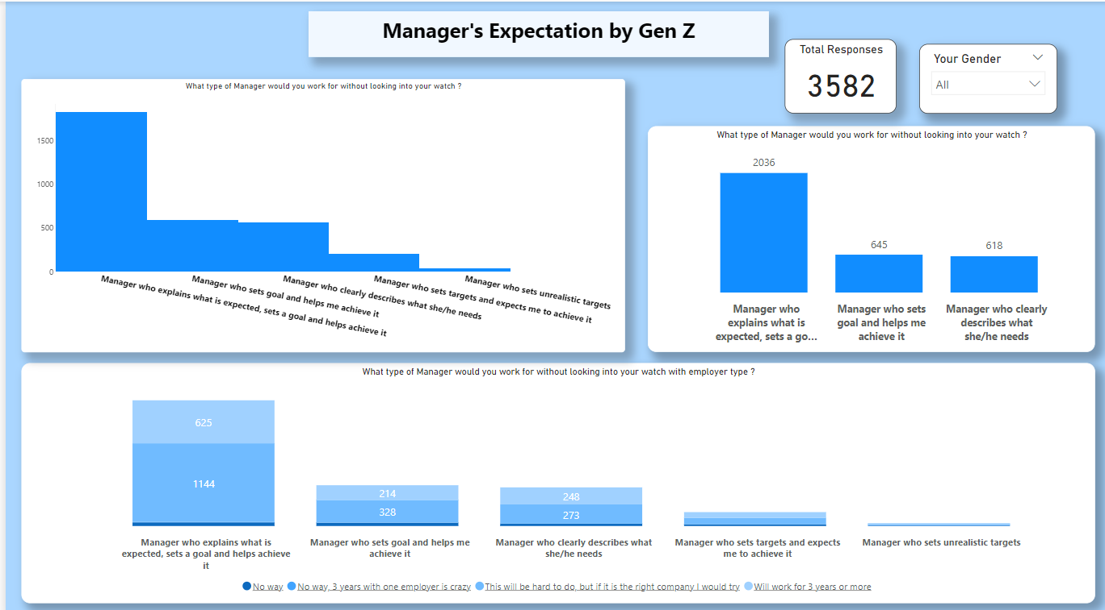
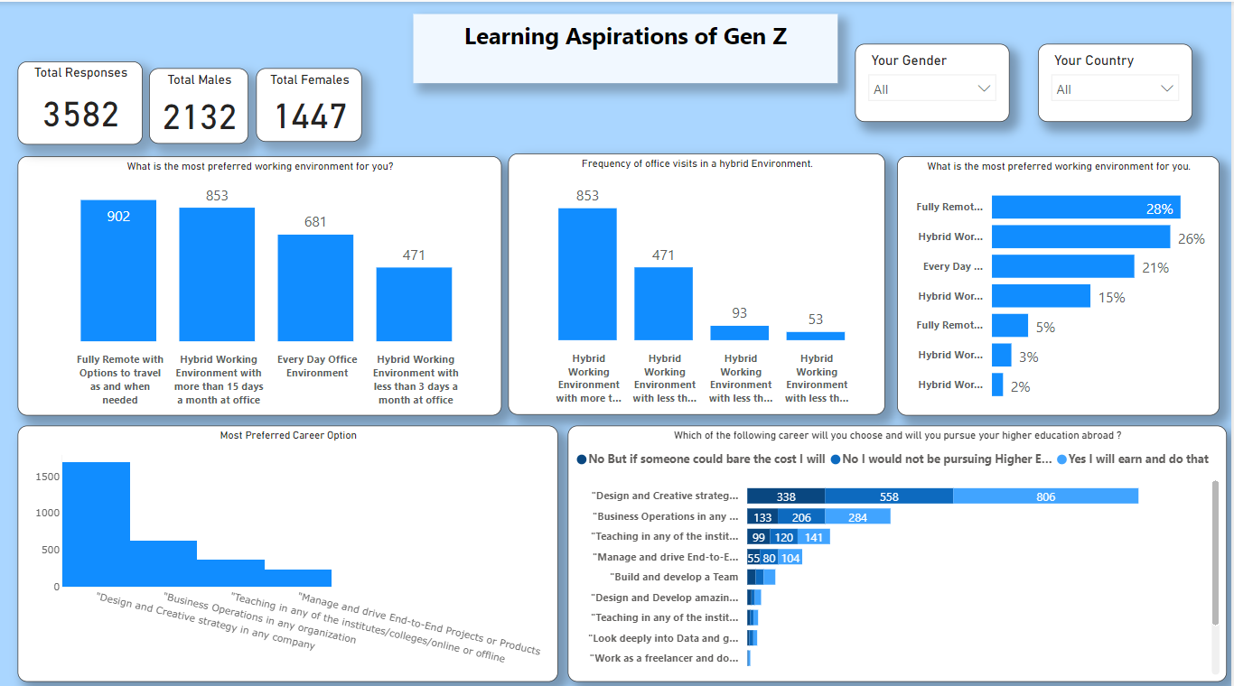
Focus Area Dashboards
We made three focused dashboards along with one comprehensive dashboard. These three dashboards were based of 3 aspects :
Mission Expectation by Gen Z
Learning Aspirations of Gen Z
Manager’s Expectation by Gen Z

Slide 9
Final Insights
Total Responses:- 3582
34% Gen Z’ s are mostly influenced by their Parents for their career.
23% are affected by people who have changed the world for better.
17% are affected by influencer who had successful careers.

Slide 10
Final Insights
Majority of the Gen Z prefer to work at the design and strategy in a company which is 56% followed by Business Operations in any organization which is 20%.
Other Career are Teaching (12%), managing end to end projects (8%) and build and develop a team (4%).

Slide 11
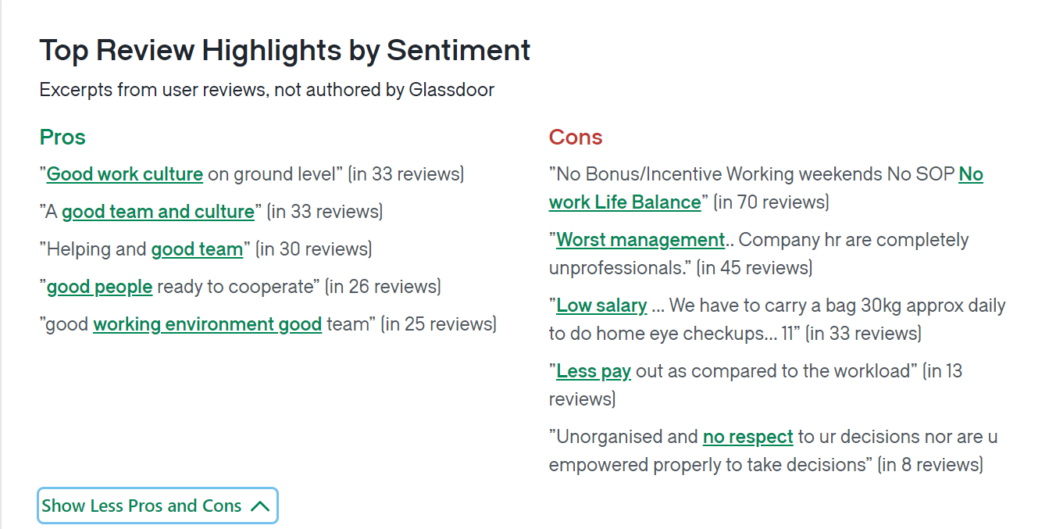
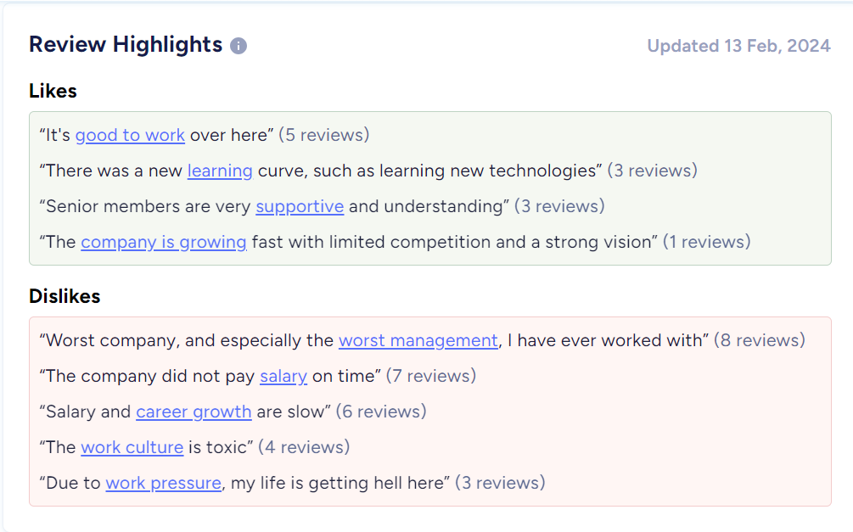
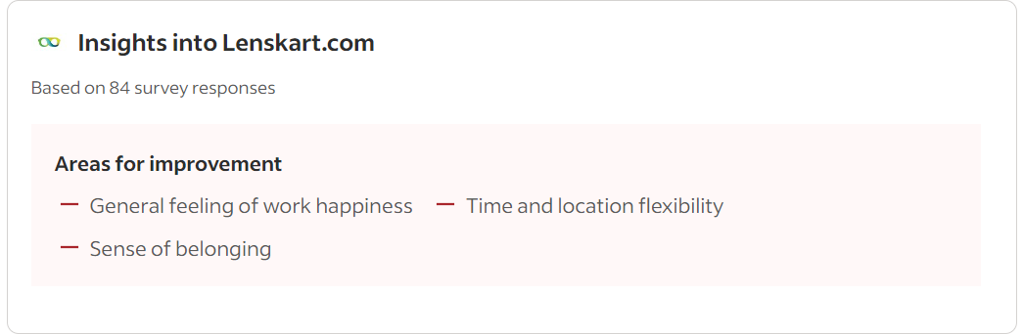
Problem At Lenskart
Wrong management of work.
Lack of feeling of happiness.
Work Pressure and toxic work culture.

Slide 12
Final Insight
Recommendations:
57% Gen Z want to work for manager who explains what is expected, sets a goal and helps achieve it.
Hence managers at Lenskart should clearly define the employees what is expected from them to ensure proper management at the company.

Slide 13
Final Insights
Recommendations:
52% of Gen Z want to work for the employer who pushes theory limits by enabling a learning environment and rewards them at the end.
At Lenskart, the employers need to provide a learning environment to the employees to reduce work pressure and generate a feeling of happiness.

Slide 14
Thank You !

